Slide 1

Hotel Recommendation System
Multimedia Communications - Final Project Presentation 2021
Pamila Viswanathan | Samarth Patel | Jaskirat Singh April 19,2021

Slide 2
Overview
Existing system
What is Recommender System?
Pros and Types of various types of Recommender System
Implemented System
Resources & Tools
Work Plan and Task Breakdown
Deliverables
References
Hotel Recommendation System Pamila Viswanathan | Samarth Patel | Jaskirat Singh

Slide 3
Existing System
Offline Store → Limited Stock → Easy to recommend but less options to select from
Online Store → Millions of Options → Information Overload
This is known as Long tail problem of online shopping.
Solution?
Hotel Recommendation System Pamila Viswanathan | Samarth Patel | Jaskirat Singh

Slide 4
Existing System
Offline Store → Limited Stock → Easy to recommend but less options to select from
Online Store → Millions of Options → Information Overload
This is known as Long tail problem of online shopping.
Solution? Recommender system
Hotel Recommendation System Pamila Viswanathan | Samarth Patel | Jaskirat Singh

Slide 5
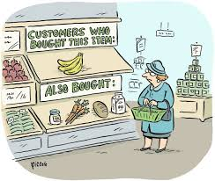
What is a Recommender System?
A Recommender System is a type of information filtering system that filters relevant information fragments from a large set of dynamically generated data based on user’s preferences, interests, or past observed behavior. Its algorithm can pinpoint accurate user preferences once it knows what users like, it can recommend them new & relevant content.
Hotel Recommendation System Pamila Viswanathan | Samarth Patel | Jaskirat Singh

Slide 6
Examples of Recommender System
Recommender systems can also enhance experiences for:
eCommerce Platforms: Amazon, Flipkart
Social Media Platforms: Facebook, Instragram
Knowledge Bases: Quora, StackOverflow
Streaming Platforms: Netflix, Amazon Prime, Disney + Hotstar
Hotel Booking: Airbnb
YouTube
Hotel Recommendation System Pamila Viswanathan | Samarth Patel | Jaskirat Singh

Slide 7
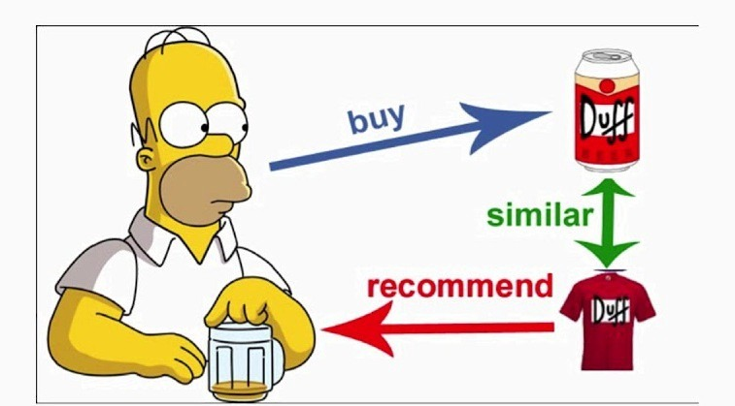
Pros of Recommender System
Personalization
Enhance Customer Experience
Boost Customer Retention
Hotel Recommendation System Pamila Viswanathan | Samarth Patel | Jaskirat Singh

Slide 8
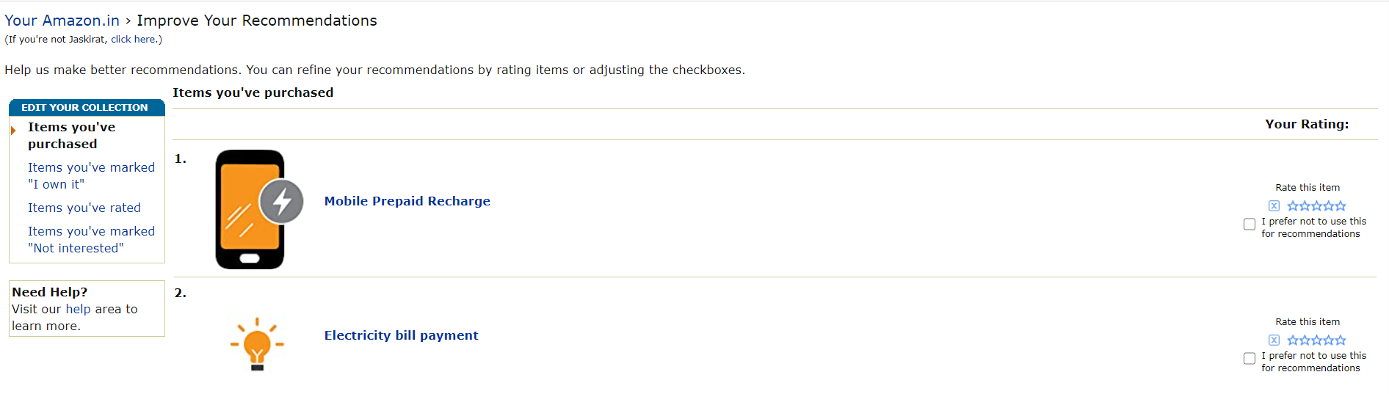
Current System used by Amazon to improve Recommendations
Hotel Recommendation System Pamila Viswanathan | Samarth Patel | Jaskirat Singh

Slide 9
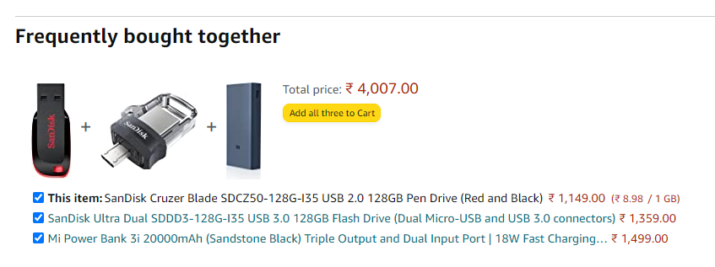
Recommendation System in general
Used in this and that
Hotel Recommendation System Pamila Viswanathan | Samarth Patel | Jaskirat Singh

Slide 10
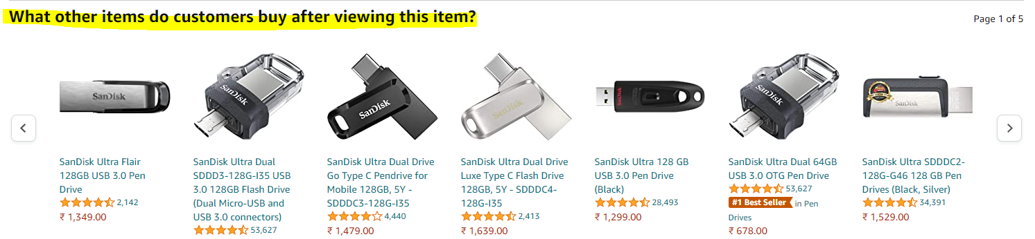
Recommendation system in general
Hotel Recommendation System Pamila Viswanathan | Samarth Patel | Jaskirat Singh

Slide 11
Types of Recommendation Systems
Collaborative Filtering
Content-based Filtering
Hybrid Filtering
Hotel Recommendation System Pamila Viswanathan | Samarth Patel | Jaskirat Singh

Slide 12
Content Based Filtering in Recommender Systems
Recommends items by comparing user profile and content of the items.
User profile built up by analyzing the content of items which have been seen by the user.
Explicit: By providing input such as rating
Implicit: By clicking on a link
Hotel Recommendation System Pamila Viswanathan | Samarth Patel | Jaskirat Singh

Slide 13
Collaborative Filtering in Recommender Systems
Recommends items based on the items previously rated by other users.
Agreement of people’s evaluation in the past.
User-Based approach - same taste one group (or) Item-based approach - Model-based algorithm (similarities between different items to find the missing rating)
Hotel Recommendation System Pamila Viswanathan | Samarth Patel | Jaskirat Singh

Slide 14
Limitations of Collaborative Filtering
Cold start problem – Require huge amount of existing data
Scalability – Huge number of computational power is needed.
Limitations of content based filtering
Does not take into account other’s opinion
Overspecialization problem

Slide 15
Implementation: Django Framework Set Up
Create and activate VTK Environment
Install Django
Start Project : django-admin startproject HRS
Start Application: python manage.py startapp catalog
Run Server: python manage.py runserver
SQLite database is default database

Slide 16
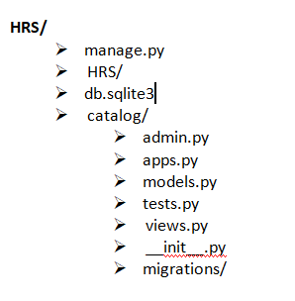
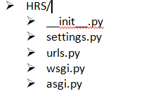
Implementation: Django Framework Set Up
.

Slide 17
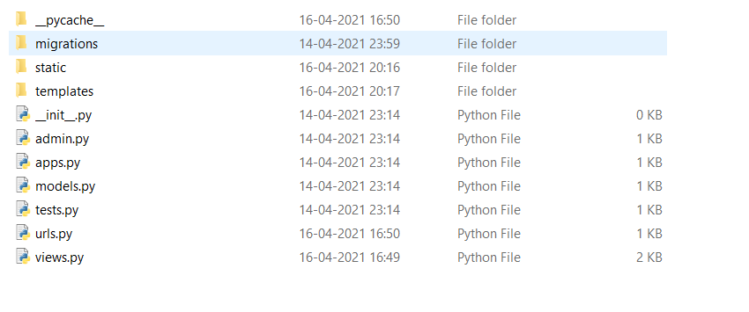
Implementation: Django Framework Set Up
.

Slide 18
Hybrid Recommender System
Data Processing:
Missing data
Cleaning train data to only include searched that resulted a purchase.
Feature Selection: 9 feature selected
E.g: 'site_name', 'user_location_region', 'is_package','srch_adults_cnt', 'srch_children_cnt','srch_destination_id', 'hotel_market', 'hotel_country', 'hotel_cluster’.
Model: Uses Extreme Gradient Boosting
Average Accuracy: ~42-45%

Slide 19
Dataset(Hotel Recommendation Dataset)
Training Dataset contains 37,70,293 rows
Test Dataset contains 2,628,243 rows
Features are classified as:
Direct Features:
Geographical: ‘user_location_region’ , ‘hotel_country’,etc.
Temporal: ‘date_time’
Search Features: ‘search destination region’, ‘srch_room_cnt’ etc.
Latent Features: Features extracted from text reviews.
Hotel Recommendation System Pamila Viswanathan | Samarth Patel | Jaskirat Singh

Slide 20
Challenges
Features Selection
The dataset contains a set of 172 features.
Model Selection Tuning and Training of a no. of models with different feature selections
Integration of UI and Recommender System
UI Design Presenting Anonymized Data
Hotel Recommendation System Pamila Viswanathan | Samarth Patel | Jaskirat Singh

Slide 21
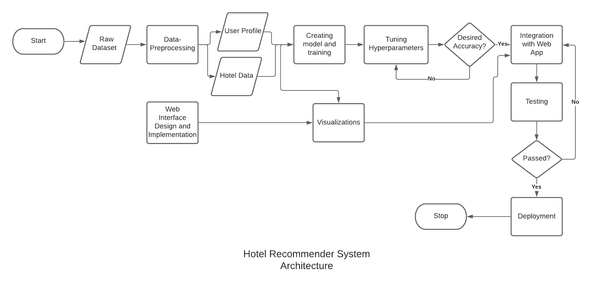
System Implementation
Hotel Recommendation System Pamila Viswanathan | Samarth Patel | Jaskirat Singh

Slide 22
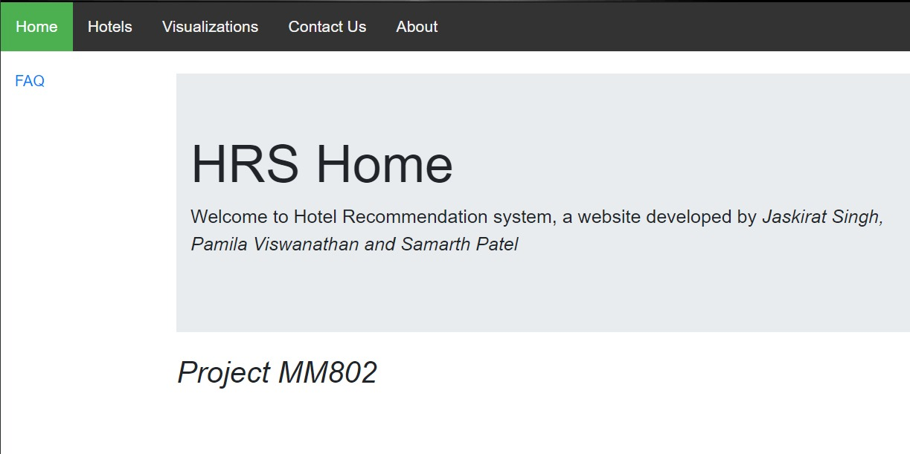
Screenshots
Hotel Recommendation System Pamila Viswanathan | Samarth Patel | Jaskirat Singh

Slide 23
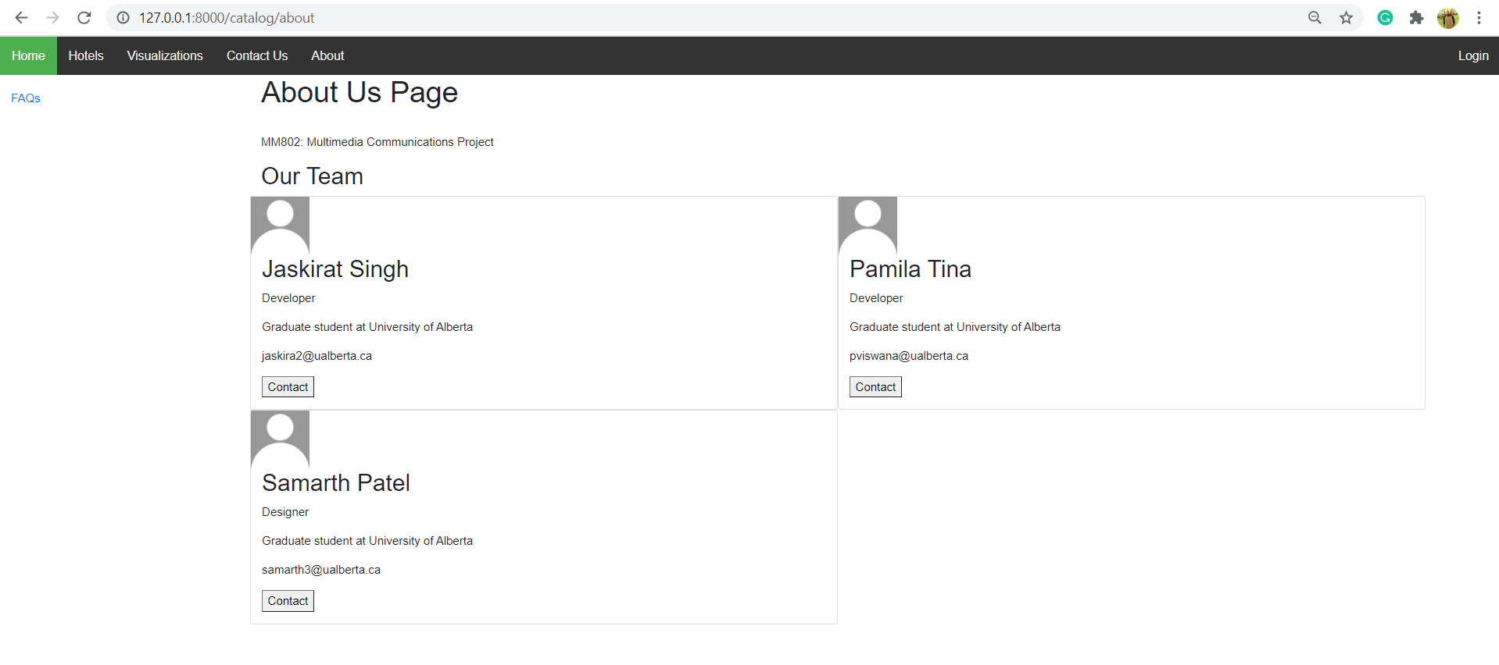
Screenshots
Hotel Recommendation System Pamila Viswanathan | Samarth Patel | Jaskirat Singh

Slide 24
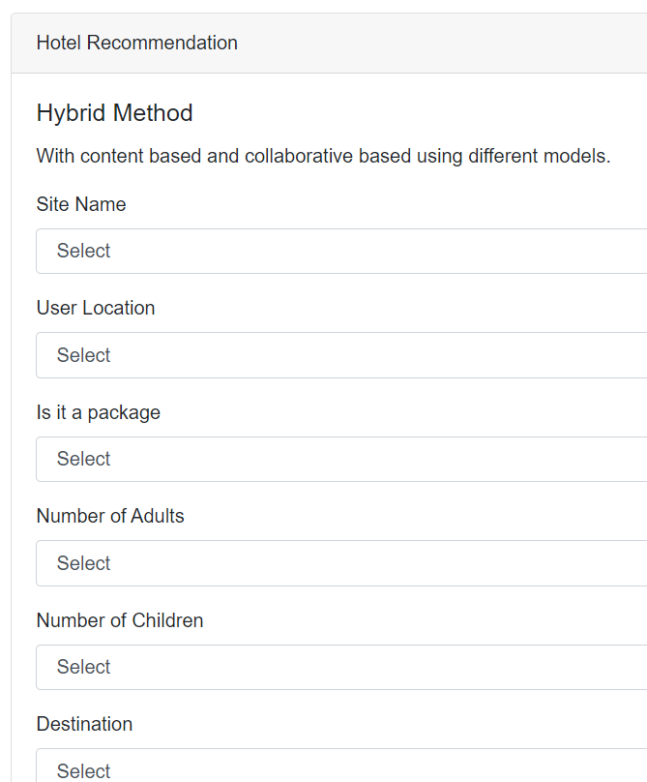
Screenshots
Hotel Recommendation System Pamila Viswanathan | Samarth Patel | Jaskirat Singh

Slide 25
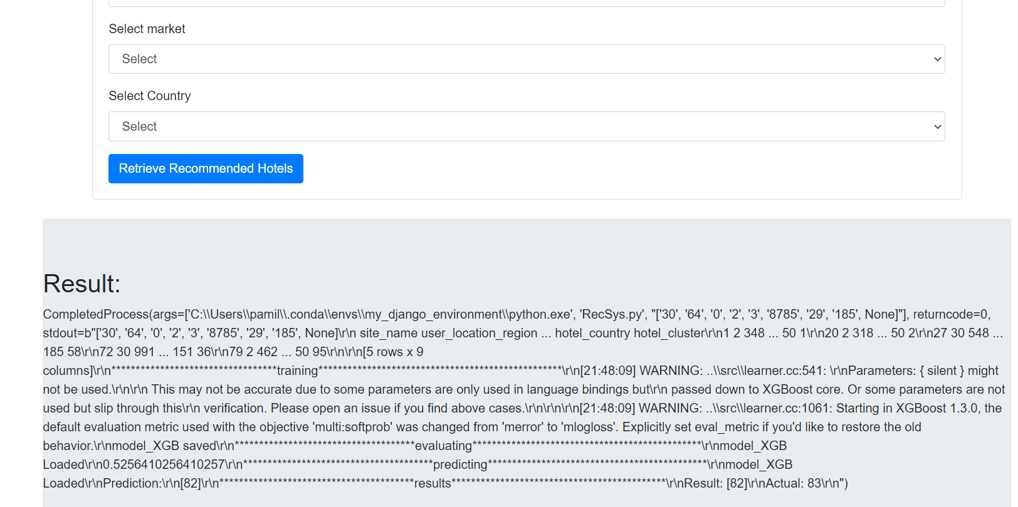
Screenshots
Hotel Recommendation System Pamila Viswanathan | Samarth Patel | Jaskirat Singh

Slide 26
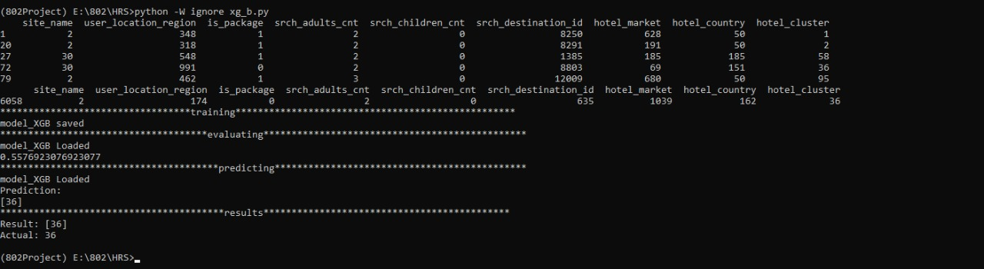
Screenshots
Hotel Recommendation System Pamila Viswanathan | Samarth Patel | Jaskirat Singh

Slide 27
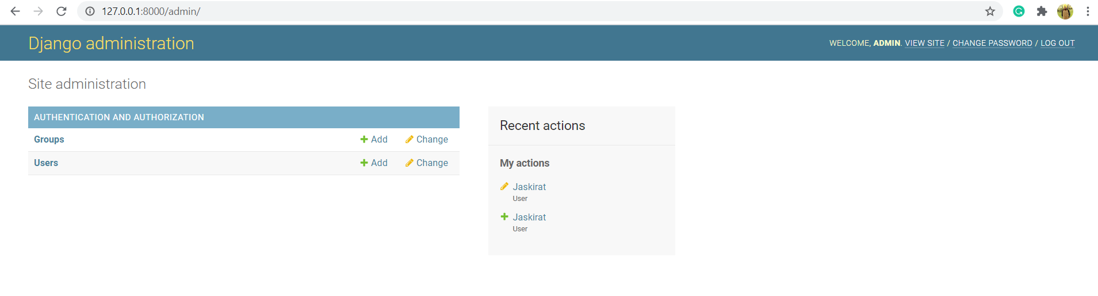
Screenshots
Hotel Recommendation System Pamila Viswanathan | Samarth Patel | Jaskirat Singh

Slide 28
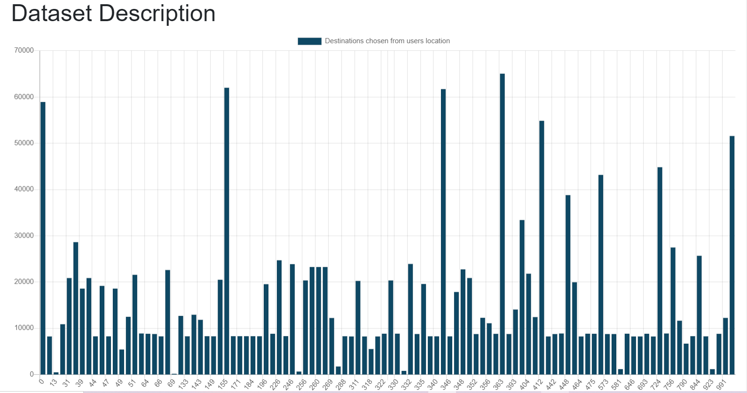
Screenshots
Hotel Recommendation System Pamila Viswanathan | Samarth Patel | Jaskirat Singh

Slide 29
Project Road Map
10 Mar
Selection of resources and implementation Tools
18 Mar
20 Feb
3 Mar
Project Presentation
Data Acquisition
Project Proposal
21 Mar
Integration Testing and Visualization
Implementation of HRS
20 Apr
15 Apr
Report & Source code Submission
30 Mar
UI development
6 Apr
Integration of UI and HRS
19 Apr
Final Project Presentation
Hotel Recommendation System Pamila Viswanathan | Samarth Patel | Jaskirat Singh

Slide 30



Resources & Tools
Web Development:
Front-End: JavaScript , CSS3, HTML5
Back-End: Python using Django-Web Framework.
Recommender System Implementation: Python
Dataset: Expedia Hotel Recommendation | Kaggle
Version control- Github
Hotel Recommendation System Pamila Viswanathan | Samarth Patel | Jaskirat Singh

Slide 31
Task Breakdown & Work Plan
Jaskirat Singh
Data Collection
Setup of Django Framework
Samarth Patel
Data Preprocessing
Implementation of HRS
Pamila Viswanathan
Data Validation
Implementation of HRS
UI Design and Implementation
Deployment and Integration Testing
Report writing
Unit Testing
Report writing
Visualization
Report writing
Integration of UI and HRS
Tuning of Hyper parameters for HRS
Hotel Recommendation System Pamila Viswanathan | Samarth Patel | Jaskirat Singh

Slide 32
Deliverables
User Interface for Recommender System.
To achieve better recommendation accuracy with the publicly available dataset.
Tackle Cold Start problem and Popularity Bias.
Visualization for metrics such as TPR vs FPR, Parameters Vs Accuracy Curve.
Hotel Recommendation System Pamila Viswanathan | Samarth Patel | Jaskirat Singh

Slide 33
References
P. Aggarwal, V. Tomar, and A. Kathuria. Comparing content based and collaborative filtering in recommender systems. In International Journal of New Technology and Research (IJNTR), volume 3, pages 65–67, 2017.
H. Li, F. Cai, and Z. Liao. Content-based filtering recommendation algorithm using hmm. In 2012 Fourth International Conference on Computational and Information Sciences, pages 275–277, 2012.
David M. Pennock, Eric Horvitz, Steve Lawrence, and C. Lee Giles. Collaborative filtering by personality diagnosis: A hybrid memory and model-based approach. In Proceedings of the 16th Conference on Uncertainty in Artificial Intelligence, UAI ’00, page 473–480, San Francisco, CA, USA, 2000. Morgan Kaufmann Publishers Inc.
Charilaos Zisopoulos, Savvas Karagiannidis, Georgios Demirtsoglou, and Stefanos Antaris. Content-based recommendation systems. 11, 2008.
https://www.iteratorshq.com/blog/an-introduction-recommender-systems-9-easy-examples/
http://citeseerx.ist.psu.edu/viewdoc/download?doi=10.1.1.695.6428&rep=rep1&type=pdf
Hotel Recommendation System Pamila Viswanathan | Samarth Patel | Jaskirat Singh

Slide 34

Thank You Q/A??
Hotel Recommendation System Pamila Viswanathan | Samarth Patel | Jaskirat Singh

